Slide 1
DataBase Design
Lecture 2

Slide 2
DataBase Design Phases
The database design process can be divided into six steps:
Requirement Analysis
Requirement Specification Document
Conceptual Database design
Logical Database Design
Physical Database Design
Application and Security Design

Slide 3
1. Requirement Analysis
The very first step in designing a database application is to understand what data is to be stored in the database.
what applications must be built on top of it.
what operations are most frequent and subject to performance requirements.

Slide 4
2. Requirement specification document

Slide 5
3. Conceptual Database Design
A conceptual data model identifies the highest-level relationships between the different entities. Features of conceptual data model include:
Includes the important entities and the relationships among them and mapping constraints. (ER model is used)

Slide 6
4. Logical Database Design
A logical data model describes the data in as much detail as possible, without regard to how they will be physical implemented in the database.
The steps for designing the logical data model are as follows:
Specify primary keys for all entities.
Find the relationships between different entities.
Find all attributes for each entity.
Resolve many-to-many relationships.
Normalization.

Slide 7
5. Physical Database Design
Physical data model represents how the model will be built in the database.
A physical database model shows all table structures, including column name, column data type, column constraints, primary key, foreign key, and relationships between tables.
The steps for physical data model design are as follows:
Convert entities into tables.
Convert relationships into foreign keys.
Convert attributes into columns.
Modify the physical data model based on physical constraints / requirements.

Slide 8
6. Application and Security Design
In this step we describe the role of each entity in every process that is reflected in some application task, as part of a complete workflow for that task.
For each role, we must identify the parts of the database that must be accessible and the parts of the database that must not be accessible, and we must take steps to ensure that these access rules are enforced.

Slide 9
Entity Relationship Model
ER model is an abstract and conceptual representation of data.
The conceptual schema design phase of databases is done using ER Diagrams.

Slide 10
Basic Theory Concepts
Entity: is any thing in real world about which you want to store information in database. For example person, book, class, course, instructor etc.
Attributes: An entity has a set of properties called attributes. For example a student entity may have a registration number, name, age, address etc
Composite Attributes: can be divided into subparts. For example attribute student name can be structured as composite attribute consisting of first name, last name.
Multivalued Attributes: There may be instances where an attribute has multiple values for a particular entity. For example student entity with attribute phone number. A student may have one or several phone numbers and different students may have different phone numbers.

Slide 11
Decision Rules for Entity Selection
Rule 1
Every entity type should be important in its own right within the problem domain.
Rule 2
IF an object type (noun) has only one property to store
THEN it is an attribute of another entity type
ELSE it is an entity type.
Rule 3
IF an object type has only one data instance
THEN do not model as an entity type.

Slide 12
Derived Attribute: The value of this type of attribute derived from other attributes when required not stored in database. For example
Student entity has attribute date of birth if we want to calculate age of student we can use date of birth and current date attribute to calculate age.
Domain or value set: For each attribute there is a set of permitted values, called domain of that attribute. For example domain of attribute student name might be set of all text strings of certain length.

Slide 13
Relationship: is an association among several entities. For example we can define a relationship that associates student ali with course database. This relationship specifies that ali is register for course databases.

Slide 14
Key For Identifying Relationships
Once entities have been assigned, we proceed to identify relationship types between those entities.
Verbs are useful candidates for relationships.
The following question is useful for identifying relationships: "What sentences can be constructed of the form Entity Verb Entity?" For example,
Employee has children (Existence relationship)
Professor teaches students (Functional relationship)
Customer places order (Event relationship)

Slide 15
Key For Identifying Relationships
Also keep in mind that all relationships are bi-directional. We should be able to state the relationship in both directions.
Expressing the relationships above in the opposite direction yields the following statements:
Children belong to employee
Students are taught by professor
Order is placed by customer

Slide 16
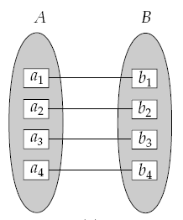

ER Model Constraints
Mapping Cardinalities: Express number of entities to which another entity can be associated via relationship set. For Binary relationship mapping cardinality must of one of following type.
• One to one. An entity in A is associated with at most one entity in B, and an entity in B is associated with at most one entity in A.
For example relationship between university and VC, department and HoD etc

Slide 17
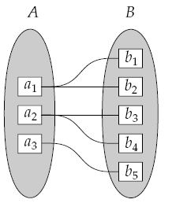

One to many. An entity in A is associated with any number (zero or more) of entities in B. An entity in B, however, can be associated with at most one entity in A
For example relationship between university and departments, university and students etc.

Slide 18
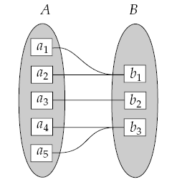
Many to one. An entity in A is associated with at most one entity in B. An entity in B, however, can be associated with any number (zero or more) of entities in A.
For example relationship between children and mother etc.

Slide 19
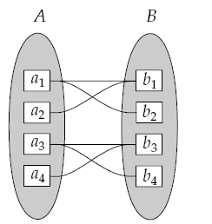

Many to many: An entity in A is associated with any number (zero or more) of entities in B, and an entity in B is associated with any number (zero or more) of entities in A.
For example relationship between student and courses, student and instructor etc.

Slide 20

Participation Constraints
IF A can exist without being associated with a B
THEN A has partial (optional) participation
ELSE A has total (mandatory) participation.
For example we expect every course entity to be related to at least one student through register for relationship. Therefore participation of course in register for relationship is total. In contrast a student can be register for course or not hence only some of student entities are related to course entity and participation of student entity in register for relationship is partial.

Slide 21
Extended ER Features
An entity set may include sub groupings of entities that are distinct in some way from other entities in the set. The process of sub grouping within an entity is called specialization or generalization.
For example consider a student entity with attributes registration number, name, and address. A student may be further classified as a teaching assistant, research assistant. Each of these types of student can be described by set of attributes that includes all attributes of student entity plus some additional attributes. In ER diagram such relationship is represented by triangle labeled with ISA.

Slide 22
Keys
A key allows us to identify a set of attributes that suffice to distinguish entities from each other. Keys also help uniquely identify relationships, and thus distinguish relationships from each other.
Primary key: A relational table uniquely identifies each record in the table.
Candidate key: A candidate key is a combination of attributes that can be uniquely used to identify a database record without any extraneous data. Each table may have one or more candidate keys. One of these candidate keys is selected as the table primary key.
Foreign key: keys are utilized to cross-reference data between relational tables.

Slide 23
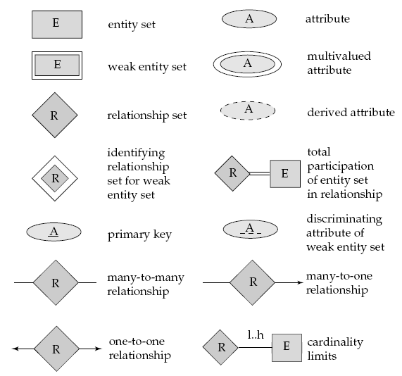
Entity Relationship Diagram Components

Slide 24
Case Study Database for a small drug store owner
The owner wants to keep track of all the suppliers who supply anything to the store.
For each supplier, the owner assigns a unique supplier number, and wants to keep the company name, address (number, street, city, state, zip), contact person's name, phone number, fax number, and a comment for each supplier.
For each supply activity, an account is established to keep track of the date incurred, the total cost of the activity, due date for payment, outstanding balance after some payments, and any special comments related to the account.
For each account, the owner may pay at several different times and in different ways (e.g., cash, check, credit card).
For each payment activity, the owner wants to keep the date of payment, amount of payment, method of payment (check: check number; credit card: credit card name, type, and number).
Note that one supplier can supply many times and one payment can pay for several accounts of the same supplier.

Slide 25
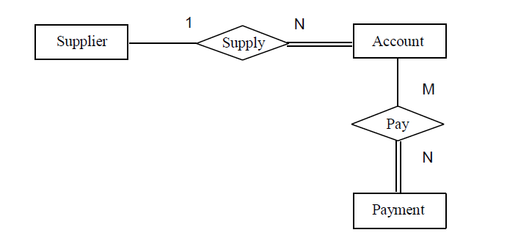
ERD with cardinality and participation constraint

Slide 26
Recommended Readings:
Chapter 2 of . Silberchatz, Korth, Sudarshan. Database System Concept

